Slide 1



Computational Thinking With Python
Midterm Skills Exam:
DATA WRANGLING AND ANALYSIS
Presentation by
John Rome A. Belocora

Slide 2


CENSUS INCOME
The term "census income" may specifically refer to the income data collected by the U.S. Census Bureau as part of the decennial census, which is conducted every ten years. This income data is used to understand the economic characteristics of the population, such as income distribution, poverty rates, and household income levels.
Information about the Dataset:
Predict whether income exceeds $50K/yr based on census data. Also known as Adult dataset.
02

Slide 3
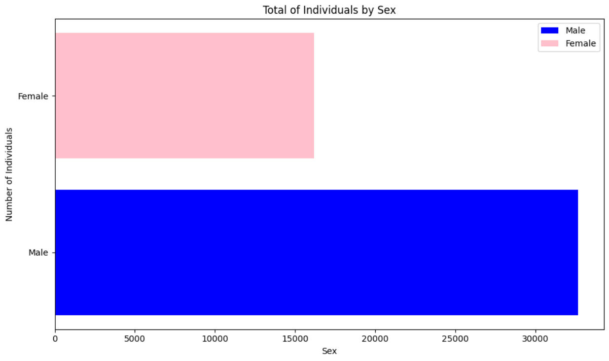
NUMBER OF INDIVIDUALS BY SEX
Male : 32650
Female : 16192
Overall : 48842
ANALYSIS
66.85% of the population is Male and 33.15% are Female
03

Slide 4

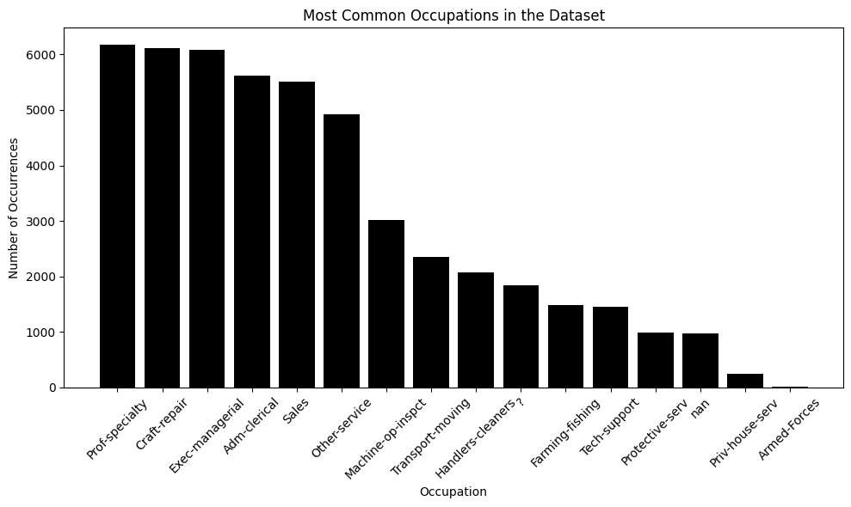
HIGHEST POPULATION OF OCCUPATION IN THE DATASET
Occupation
Prof-specialty = 6172
Craft-repair = 6112
Exec-managerial = 6086
Adm-clerical = 5611
Sales = 5504
Other-service = 4923
Machine-op-inspct = 3022
Transport-moving = 2355
Handlers-cleaners = 2072
? = 1843
Farming-fishing = 1490
Tech-support = 1446
Protective-serv = 983
nan = 966
Priv-house-serv = 242
Armed-Forces = 15
04

Slide 5

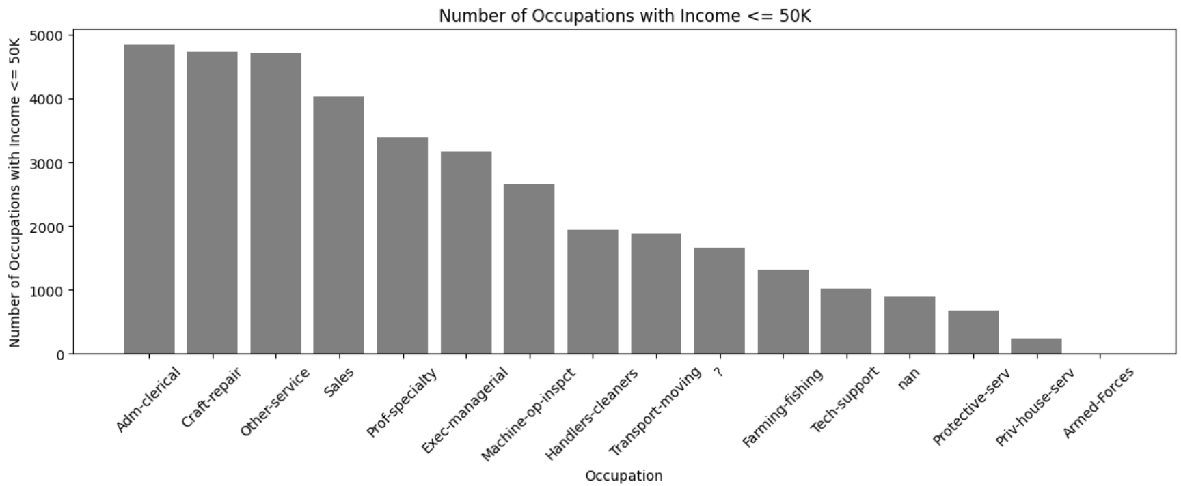
NUMBER OF OCCUPATION WITH THE INCOME OF <=50K$
Occupation
Adm-clerical = 4843
Craft-repair = 4729
Other-service = 4719
Sales = 4029
Prof-specialty = 3388
Exec-managerial = 3178
Machine-op-inspct = 2650
Handlers-cleaners = 1934
Transport-moving = 1874
? = 1652
Farming-fishing = 1317
Tech-support = 1026
nan = 892
Protective-serv = 675
Priv-house-serv = 239
Armed-Forces = 10
05

Slide 6
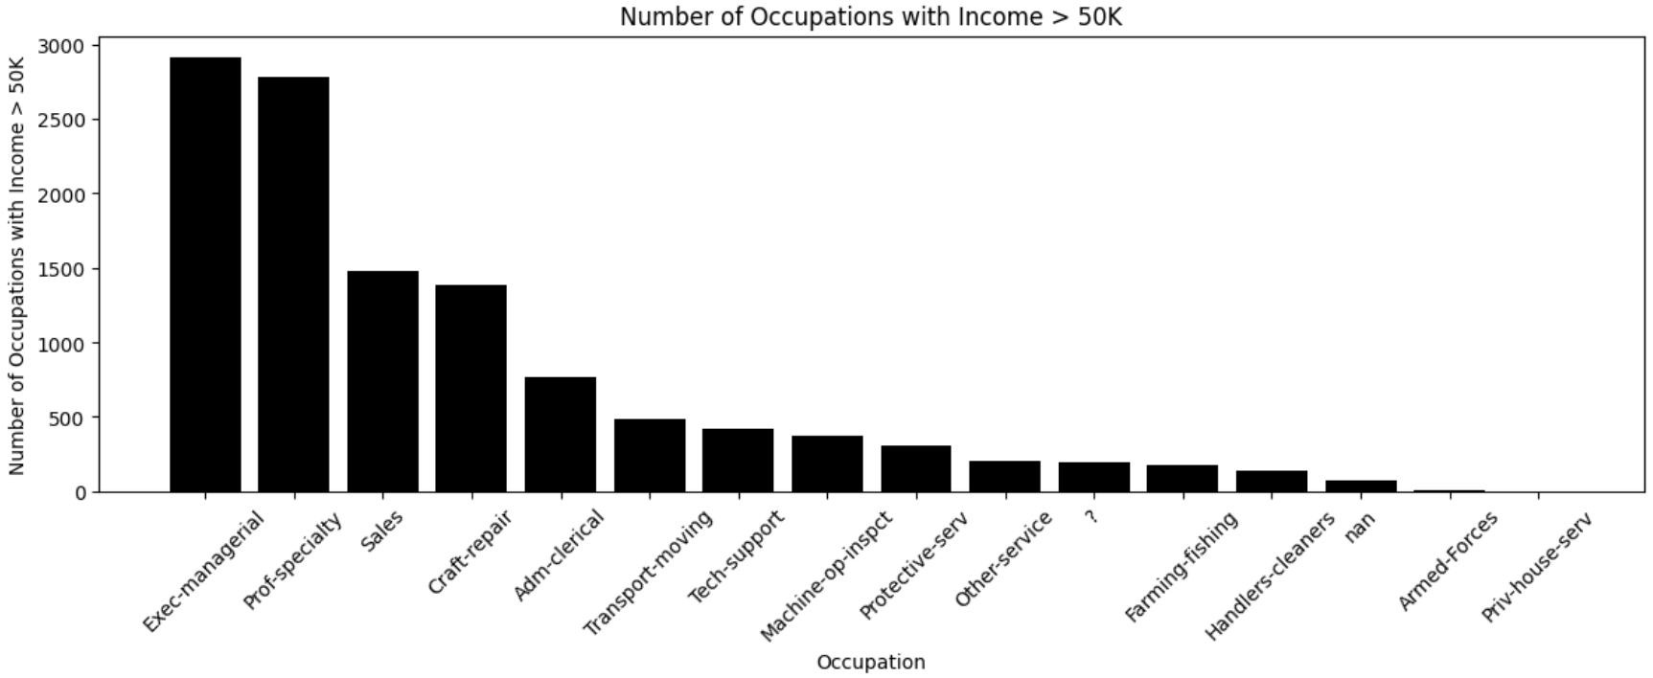
HIGHEST OCCUPATION WITH THE INCOME OF >50K$
Occupation
Exec-managerial = 2908
Prof-specialty = 2784
Sales = 1475
Craft-repair = 1383
Adm-clerical = 768
Transport-moving = 481
Tech-support = 420
Machine-op-inspct = 372
Protective-serv = 308
Other-service = 204
? = 191
Farming-fishing = 173
Handlers-cleaners = 138
nan = 74
Armed-Forces = 5
Priv-house-serv = 3
The Exec-managerial ranking as the Highest occupation with the income of >50K$.
The 2,908 population of it means 5.95% of the population are Exec-managerial based on the dataset.
06

Slide 7
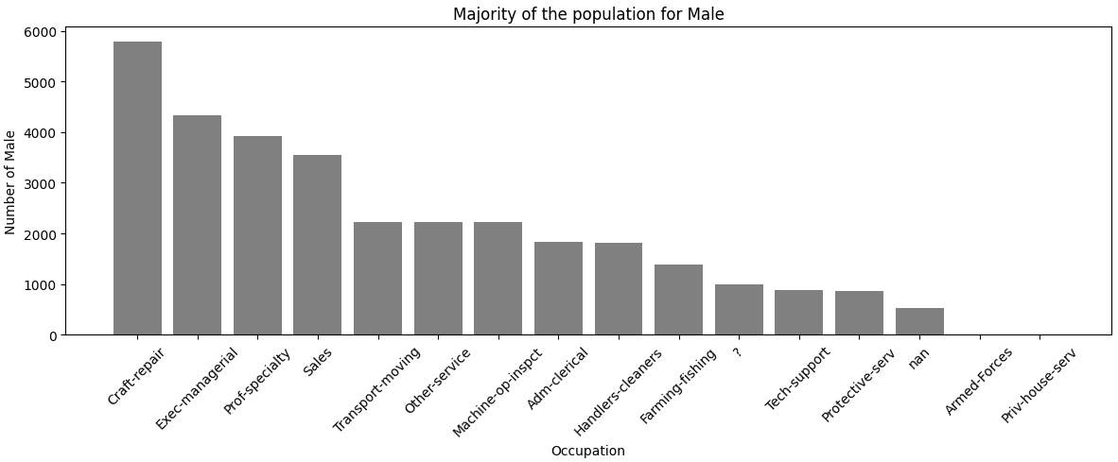
HIGHEST OCCUPATION DEPENDING ON GENDER (MALE)
Occupation
Craft-repair = 5789
Exec-managerial = 4338
Prof-specialty = 3930
Sales = 3557
Transport-moving = 2228
Other-service = 2225
Machine-op-inspct = 2218
Adm-clerical = 1842
Handlers-cleaners = 1818
Farming-fishing = 1395
? = 1002
Tech-support = 884
Protective-serv = 861
nan = 534
Armed-Forces = 15
Priv-house-serv = 14
The 4 most common occupations among males are:
Craft-repair = 32.88%
Exec-managerial = 24.63%
Prof-specialty = 22.32%
Sales = 20.17%
07

Slide 8
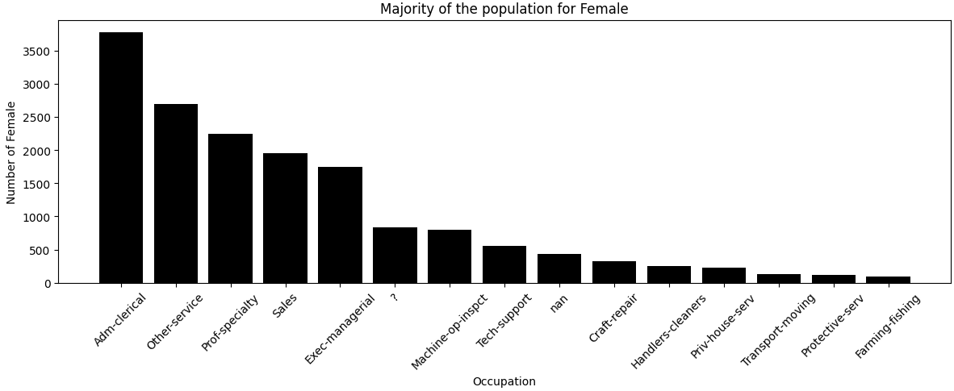
HIGHEST OCCUPATION DEPENDING ON GENDER (FEMALE)
Occupation
Adm-clerical = 3769
Other-service = 2698
Prof-specialty = 2242
Sales = 1947
Exec-managerial = 1748
? = 841
Machine-op-inspct = 804
Tech-support = 562
nan = 432
Craft-repair = 323
Handlers-cleaners = 254
Priv-house-serv = 228
Transport-moving = 127
Protective-serv = 122
Farming-fishing = 95
The 4 most common occupations among females are:
Adm-clerical = 35.37%
Other-service = 25.32%
Prof-specialty = 21.05%
Sales = 18.26%
08

Slide 9

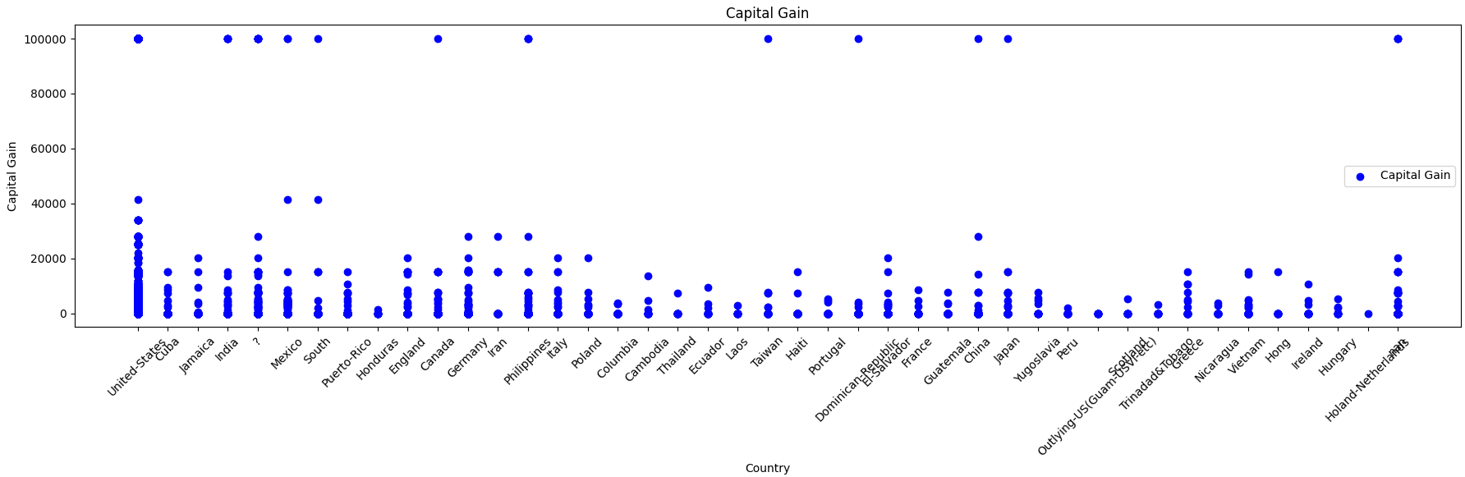
CAPITAL GAIN OF COUNTRIES
Capital gain is an economic concept defined as the profit earned on the sale of an asset which has increased in value over the holding period
09

Slide 10

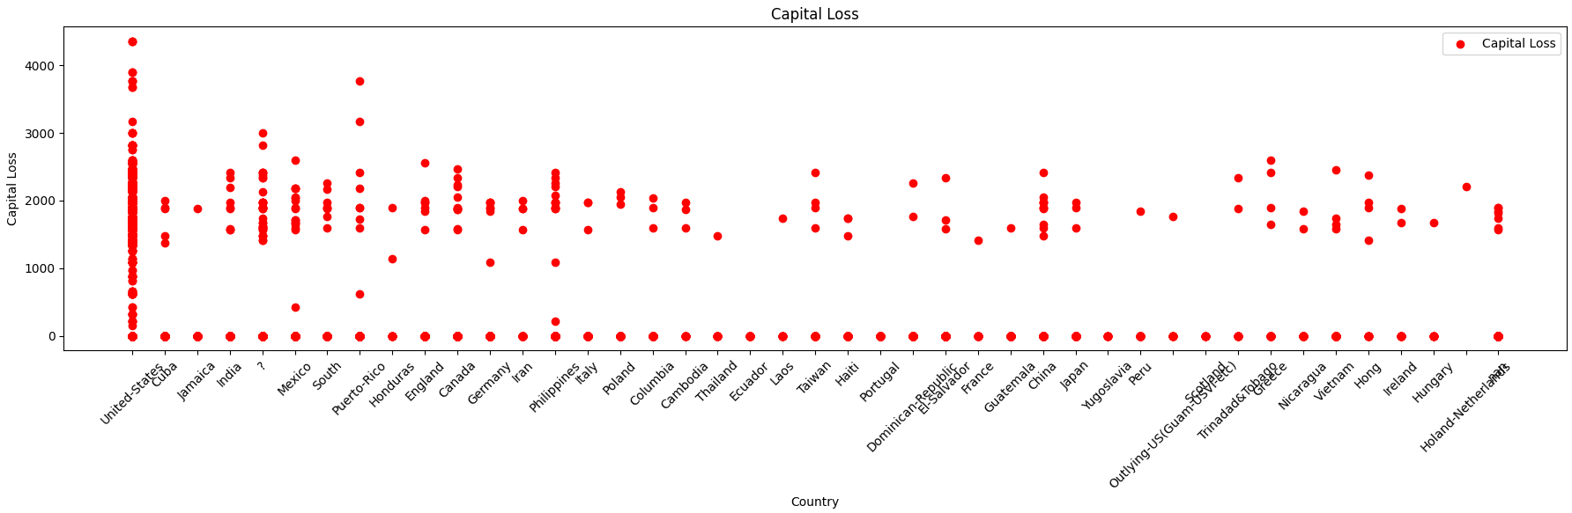
CAPITAL LOSS OF COUNTRIES
Capital loss is the loss incurred when a capital asset, such as an investment or real estate, decreases in value
10

Slide 11
CAPITAL LOSS OF COUNTRIES
Capital loss is the loss incurred when a capital asset, such as an investment or real estate, decreases in value
10

Slide 12
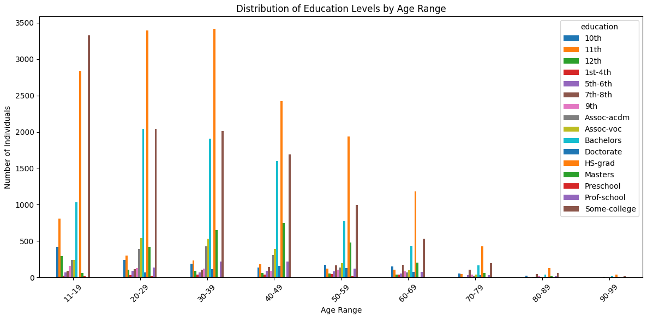
DISTRIBUTION OF EDUCATION LEVELS BY RANG
10

Slide 13

DATA ANALYSIS
The census data analysis provides valuable insights into the demographic, occupational, and educational characteristics of the population. By understanding these aspects, policymakers, researchers, and other stakeholders can make informed decisions and develop targeted interventions to address any disparities and promote socioeconomic development. Analyzing the distribution of occupations among males and females provides insights into the employment patterns within the population. By identifying the most common occupations for each gender, we gain an understanding of the occupational preferences and trends.

Slide 14
THANK YOU!
Presentation by
John Rome Belocora
references: https://archive.ics.uci.edu/dataset/20/census+income

